Slide 1
Competitive Analysis: Portfolios
Kyudong Nam
A97419572
Due 2012-01-09

Slide 2
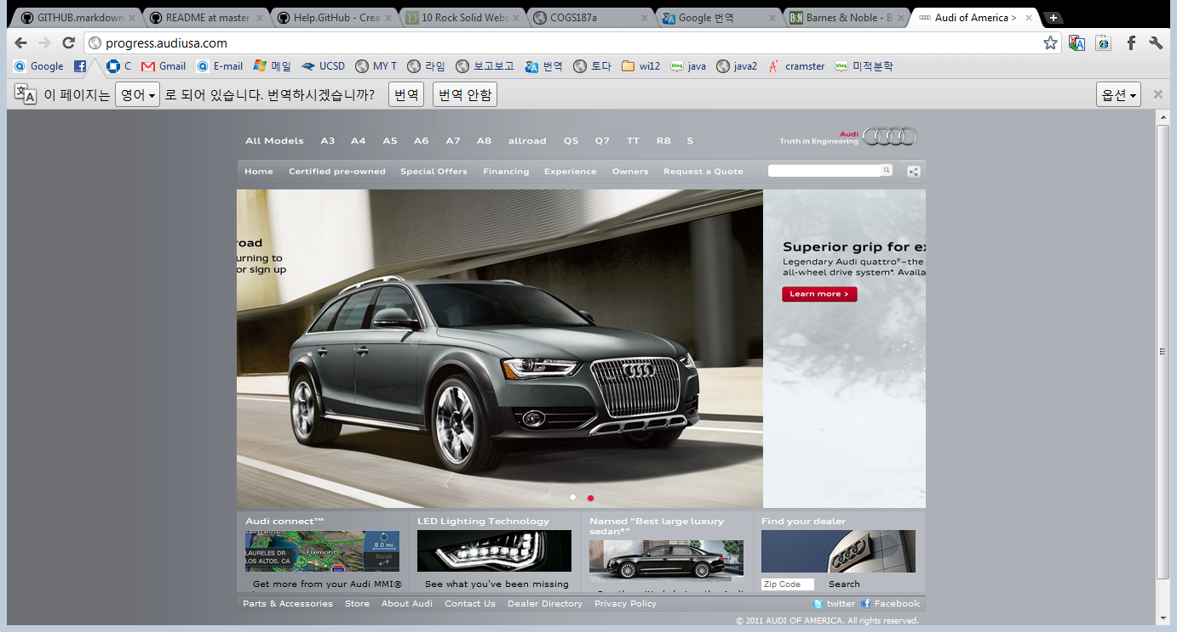
AUDI – Five Boxes 2012-01-18
http://progress.audiusa.com/

Slide 3
Brand
The picture in the middle of the page keeps changing so it gives new information of cars to customer.
In addition, it makes people to pay attention by changing pictures that are in the middle of this page.

Slide 4
Functionality
The picture of each model shows up when customer put mouse cursor on each models on the top.
By doing this, it is very helpful to understand what kind of model customers are exactly looking for.

Slide 5
Interactivity
They provide information very simply through the simple design and color.
This is not colorful website.

Slide 6
Navigation
When customers are different page, they can easily get back, because the navigation bar is still up. Customers can easily go to other model’s page.

Slide 7
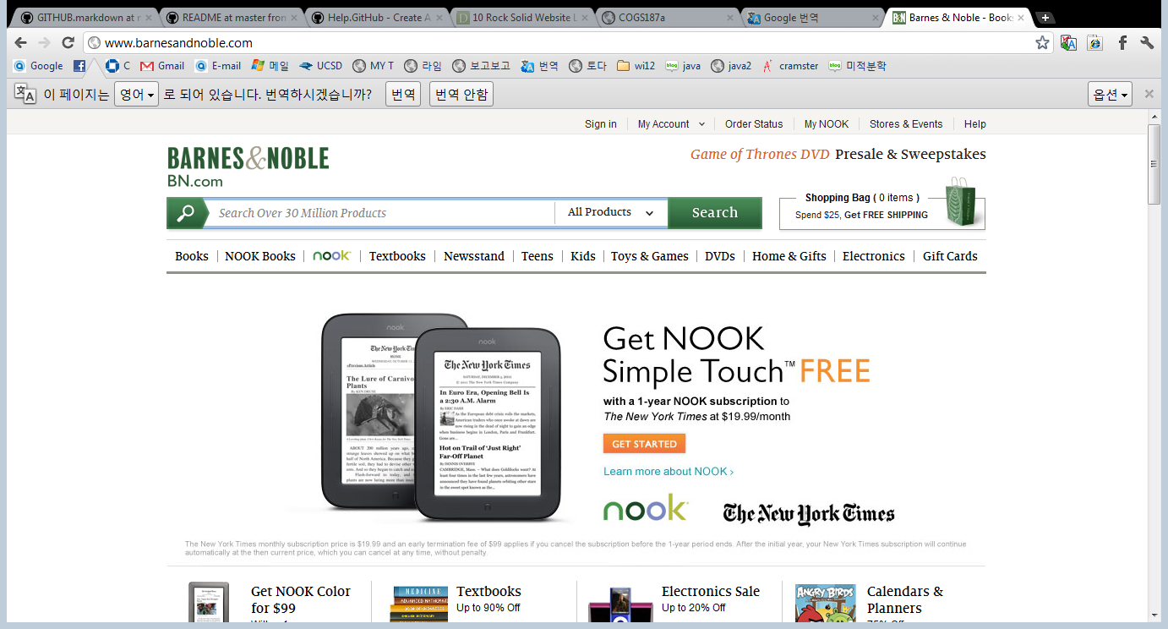
Barnes & Nobles – Power Grid 2012-01-18
http://www.barnesandnoble.com/

Slide 8
Brand
It is not fun and childish. There is no such a moving pictures.

Slide 9
Functionality
This site is well organized. All the buttons are well-positioned. If you put mouse point over the button, extra information comes up to find what you are looking for.

Slide 10
Interactivity
It provides cover flow. When you see the hot books on first page of the site, there is arrows to see more books.

Slide 11
Navigation
Even you go to different page, there is always the search bar. So, you could always search the items what you want.

Slide 12
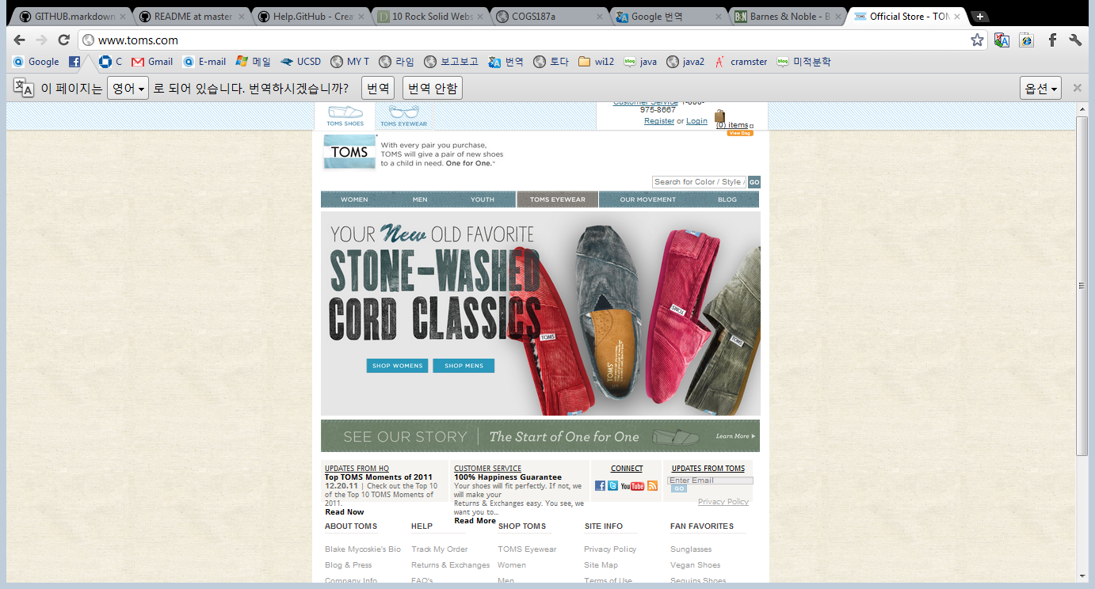
Toms – Five Boxes 2012-01-19
http://www.toms.com/

Slide 13
Brand
The pictures that on the middle of the site are changing every few seconds. It provides various products to introduce.

Slide 14
Functionality
It has several menus: WOMEN, MEN, YOUTH, TOMS EYEWEAR, etc., It perfectly help customer to find the specific product.

Slide 15
Interactivity
It does not have a cover flow. However, the color of web-site is very smooth. Meanwhile, the color of web-site fits the color of their products which means, make eyes comfortable.

Slide 16
Navigation
As I mentioned before, there are a table such as WOMEN, MEN, YOUTH, TOMS EYEWEAR, etc., So, if you go to different page, you could easily get back.

Slide 17
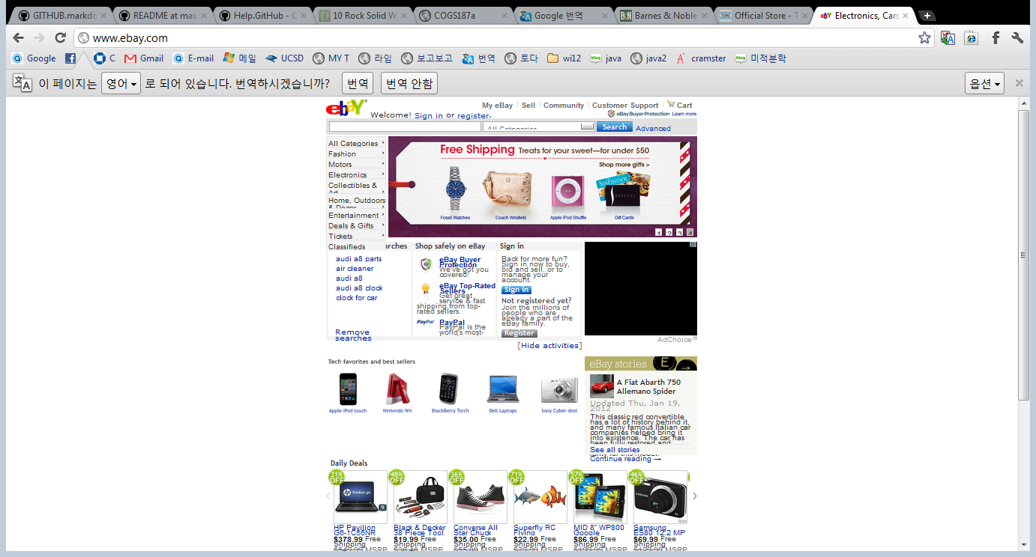
Ebay – Fixed Sidebar 2012-01-18
http://www.ebay.com/

Slide 18
Brand
It has no interesting things. It seems hard to get people’s attention on the site.
One thing is that it provides sale-items on the first page.

Slide 19
Functionality
The left side-bar provides several menus. When put mouse point over, one more menu comes up for categorized menu.

Slide 20
Interactivity
There is 4 small boxes at the edge of right corner that gives additional information.

Slide 21
Navigation
If you go to different page, menus are categorized as ‘Browse by’, which help to find menu easily.

Slide 22
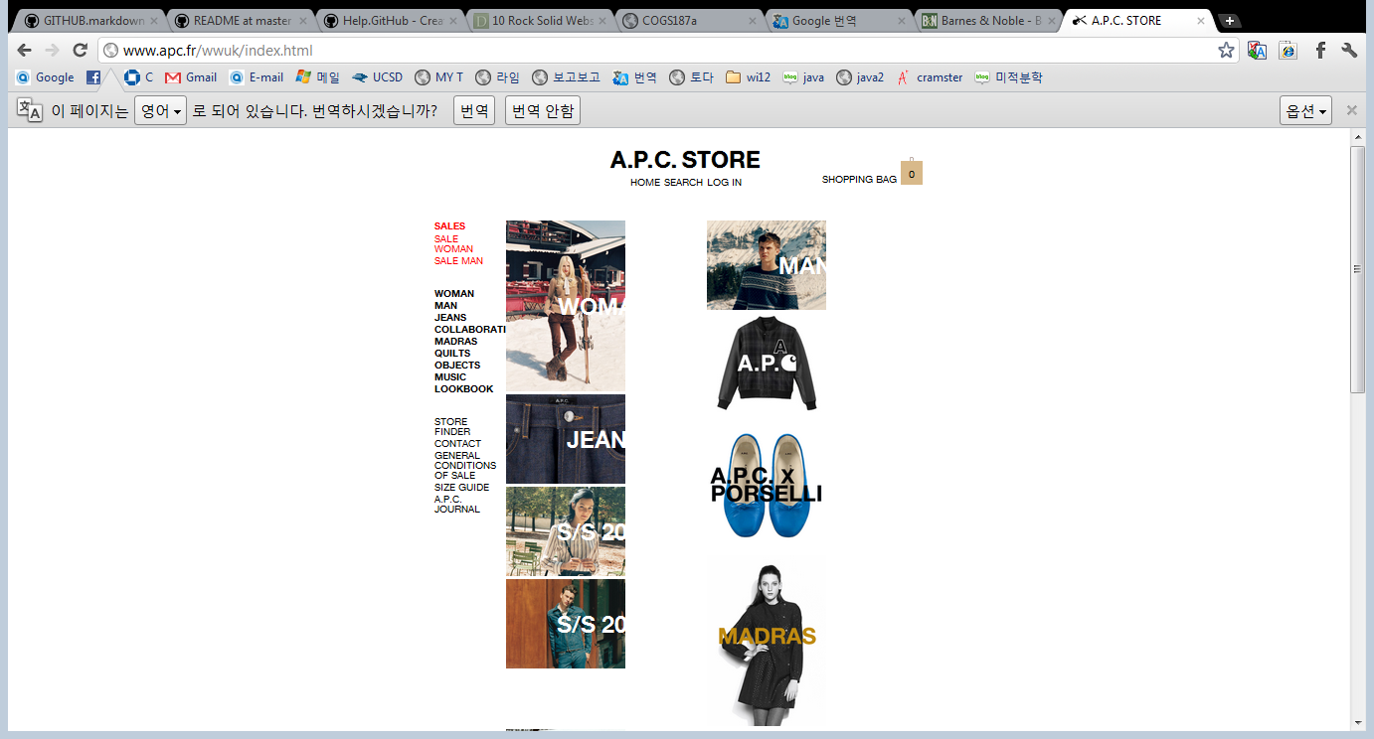
A.P.C. – Featured Photo 2012-01-18
http://www.apc.fr/wwuk/index.html

Slide 23
Brand
It is simply well-designed. When you see the first page, there are many models and make people to look at. Also, there is shoes that changes color every second.

Slide 24
Functionality
Wherever you click in, the left-side bar remains, so you can easily go back.

Slide 25
Interactivity
When you put mouse on the item, a product description shows up to help what kind of item now you are watching.

Slide 26
Navigation
When you go to different page, there is a root on the left-top such as HOME/MEN/SWEATER. So, if you go to home or previous page, you could easily click it.

Slide 27
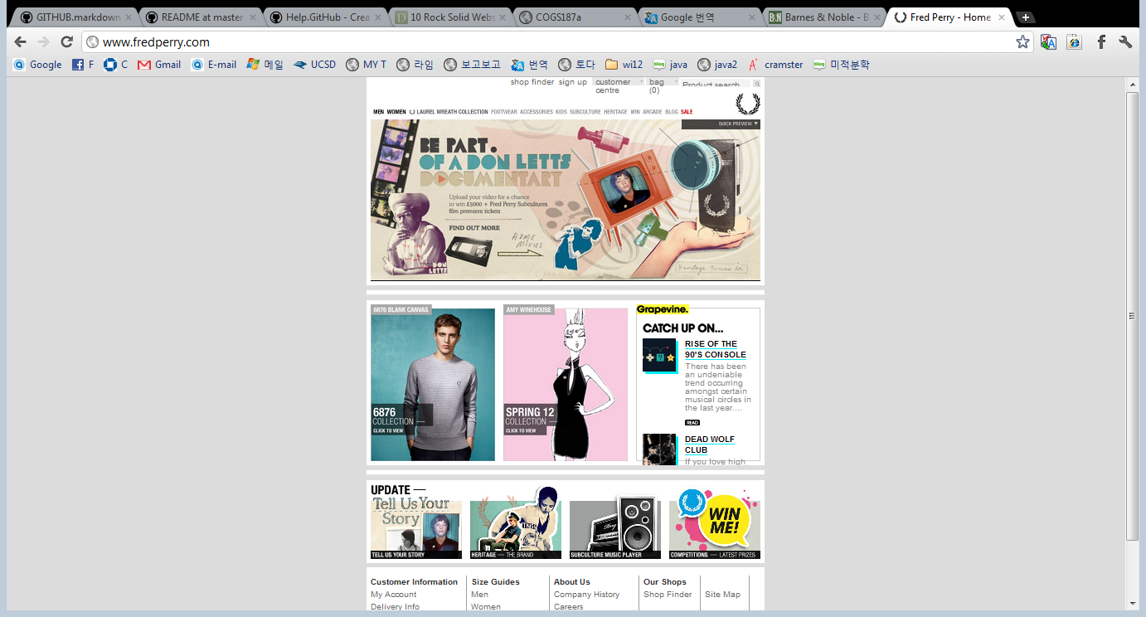
Fred Perry – Power Grid 2012-01-18
http://www.fredperry.com/

Slide 28
Brand
When I first see the page, the whole site was filled by red color. After one second, menu showed up while red page is disappearing. It makes me to interesting.

Slide 29
Functionality
When I put mouse over the product, the name of product and price show up blur.

Slide 30
Interactivity
There is a function on product page, which is ‘Click to zoom’. If you click it, enlarged picture shows up so you could see details.

Slide 31
Navigation
It is set up to move to other page easily by the menu of top always remain.

Slide 32
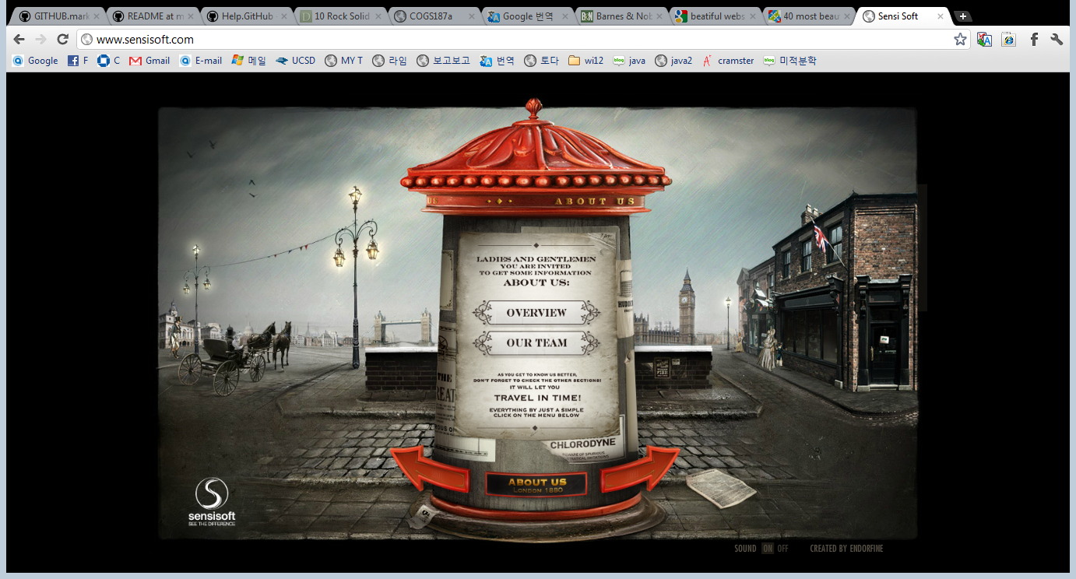
Sensi soft – Full Screen Photo 2012-01-18
http://www.sensisoft.com/

Slide 33
Brand
This website is very enough to make people interesting. A song plays when you get in. Also, you can turn the music off, if you don’t like. The background is moving while staying on the page.

Slide 34
Functionality
When I click the poster that I want to read, a poster comes up with an animation.

Slide 35
Interactivity
When I put mouse on the next button. It comes up. In addition, when I remove my mouse cursor from the next button, it goes back and moves like beating.

Slide 36
Navigation
It is so hard to know where I am. It seems easy to lost.

Slide 37
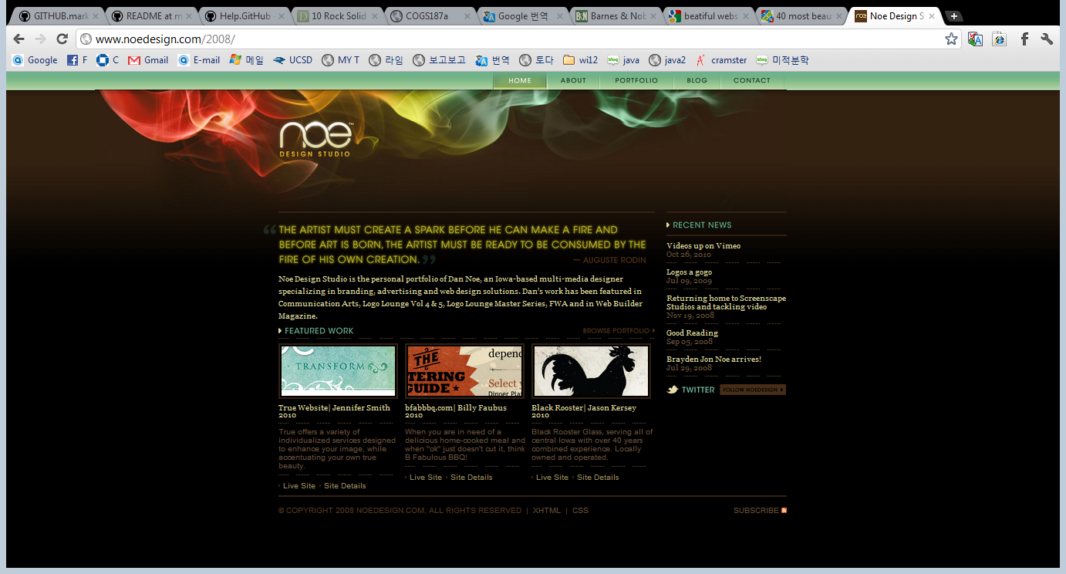
Noe Design Studio 2012-01-19
http://www.noedesign.com/

Slide 38
Brand
This is a site of design company. On the first page, there are sites what they created.

Slide 39
Functionality
When I click the websites what they have made, it automatically moves to other sites.

Slide 40
Interactivity
The color of texts changes, when I put mouse on the special texts such as Live sites, Site Details.

Slide 41
Navigation
Wherever I go, there is a menu bar still remains, so it is easy to go to previous page.

Slide 42
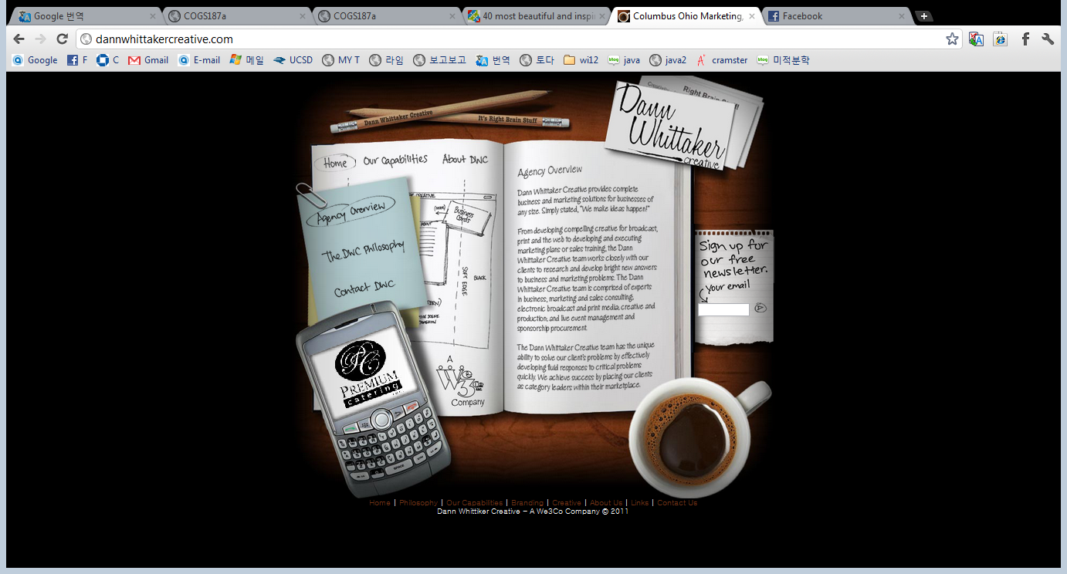
Dann Wittaker Creative 2012-01-19
http://dannwhittakercreative.com/

Slide 43
Brand
This is a web agency providing marketing solutions for business of any size.
This site looks like a desk, which is very interesting.

Slide 44
Functionality
By going different page, the menu on post it changes.

Slide 45
Interactivity
When you put mouse on the menu, an underline comes up so it let you know where your mouse is on.

Slide 46
Navigation
This site is very simple. There are no many menus, so if you are different page, you could go to other page easily.

Slide 47
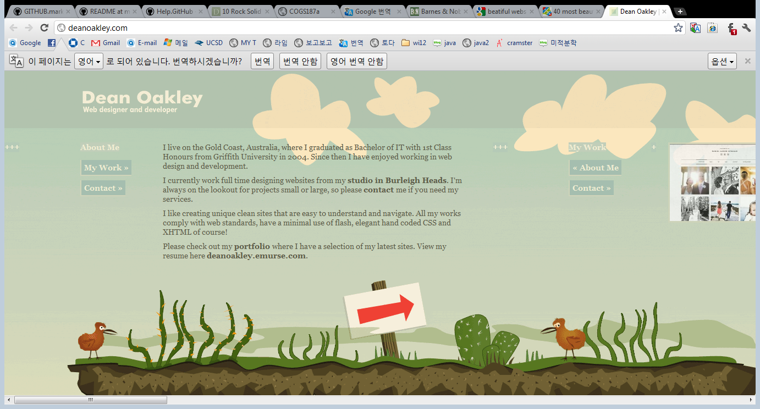
Dean Oakley 2012-01-18
http://deanoakley.com/

Slide 48
Brand
This site is the online portfolio of aussie designer Dean Oakley. The color of the website is very animatic.

Slide 49
Functionality
When I try to click the button, the edge of the button’s color changes, so it seems the button come up.

Slide 50
Interactivity
When I click the button to see other information, the site moves to the site smoothly.

Slide 51
Navigation
It is so easy to go to other pages because there are only three menus: My works, Contact, and About Me.

Slide 52
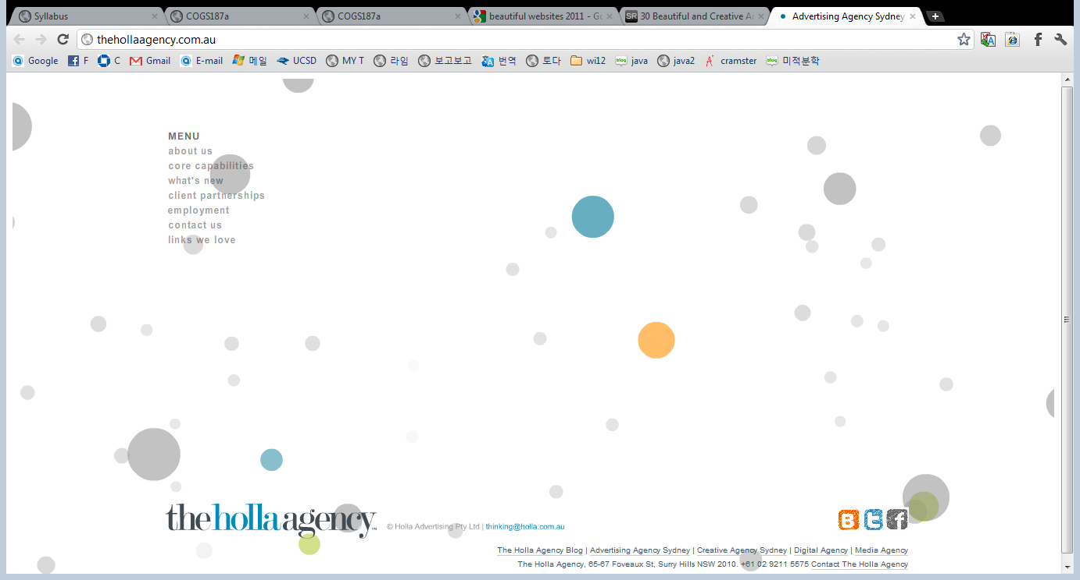
The Holla Agency 2012-01-20
http://thehollaagency.com.au/

Slide 53
Brand
This is the most interesting website I have ever seen. While the site is moving, the background is also moving. Also, there are colored dots and un-colored dots. Those colored dots are menus.

Slide 54
Functionality
When I click the button that I want to, the dot gets bigger and the information come up.

Slide 55
Interactivity
By moving mouse, the website is also moving. Also, when I put mouse on the colored dot, it tells what menu that I am looking at right now.

Slide 56
Navigation
Even there are many dots for menus and design, there is a menu bar exist. So, I don’t have to worry about lost.

